Slide 1
Introduction to C#
(Part 1)

Slide 2
Objectives
At the end of this lecture, you will be able to explain the essentials of C# programming:
My First C# program
Data Types
Variables & Constants
Operators
Selection structure (if … else)
Repetition structure (for / while loop)
Methods
Notes:
Welcome to part 1 of the introduction to C#. In this lesson, you will learn the essentials of C# programming including how to write your first C# program, what are data types, variables and operators. You will also be learning the simple C# control structure such as selection structure and repetition structure. Last but not least, you will learn methods in C# programming.

Slide 3

What is C#
C# is designed for building applications that run on the .NET Core.
Object-oriented programming language
Strong resemblance to Java
Warning: C# is case-sensitive.
Notes:
C# is designed for building applications that run on the .NET Core. It is an Object-oriented programming language that has strong resemblance to Java. Do note that C# is case-sensitive.

Slide 4
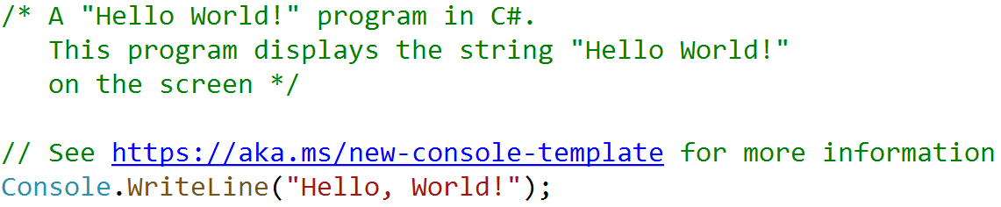
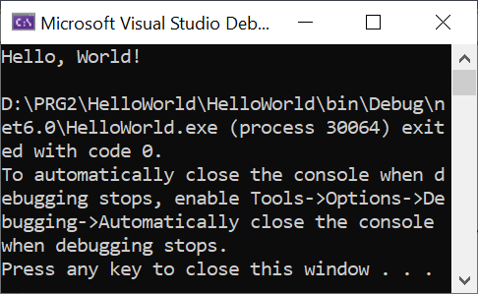
My First C# Program _{…/1}
This is the Main program without Main method is generated using top-level statements feature which minimizes the code you write.
A project can have only one file with top-level statements.
This is similar to Python.
Output :
Notes:
The screenshot shows a simple C# Main program that displays the text Hello world. This Main program without the Main method is generated using top-level statements feature. This is a new feature introduced starting in C# Version 9. Next slide will show you the traditional C# program with Main method.

Slide 5
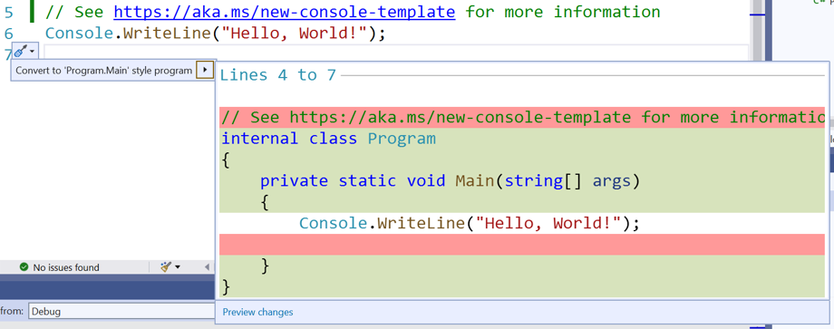
My First C# Program _{…/2}
This is the equivalent traditional C# Main program with Main method.
Next few slides will based on this program to explain each of these statement in details.
Notes:
This is the equivalent traditional C# program with Main method.

Slide 6

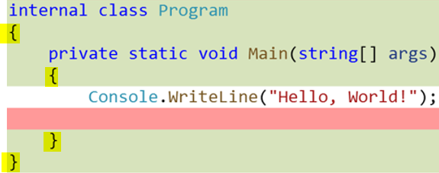
My First C# Program _{…/3}
Comments:
// - single line comments
/* … */ - span multiple lines
Comments are ignored when your program compiles.
Document what your program does.
All statements end with a ; semi-colon.
Classes and methods
begin with { end with a }
Blocks
define scope (or lifetime and visibility) of program elements.
Any statements within and including { and } define a block.
Notes:
First of all, it is a good practice to include some comments to describe the purpose of the program or even the name of the author and when the program was created. There are 2 ways to denote comments. Either type it after two slashes for single line or enclose it within the slash asterisk and asterisk slash. The later is a convenient way for comments span multiple lines.
All complete C# statements must end with a semi-colon. For example, the statement Console.WriteLine as shown here.
Statements in all classes and methods are to be enclosed in a pair of braces. For example, there’s a pair of braces to enclose statements in the program class. There’s another pair of braces to enclose statements in the main method. For any block of code, it will be enclosed in a pair of braces as well. You will see this when you learn the if-else statements and loops.

Slide 7
My First C# Program _{…/4}
Main method:
The starting and ending of a C# console program
In the past, C# console program must contain a Main method.
With top-level statements feature, you don’t have to explicity include a Main method.
The compiler generates a class and Main method entry point.
Notes:
In the past, all C# console program must contain a Main method. This is where the program execution begins and ends. With top-level statements feature, you don't have to explicitly include a Main method in a Console App project. The compiler generates a class and Main method entry point for the application.

Slide 8
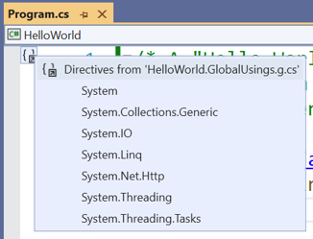
Additional Information
namespace keyword:
To be used to declare a namespace.
To declare your own namespaces can help you control the scope of class and method names in a larger programming projects.
using directive:
To simplify the code to be written, need not to fully qualifying them.
Example: If you include using System; in the program, you can write Console.WriteLine() instead of System.Console.WriteLine()
It must come first in the Main program.
Most common namespace are included globally.
Note : You will get to see/use the above in future.
Notes:
The namespace keyword is used to declare our namespace. This is useful for a larger programming projects.
The using directive simplify the code to be written. As we are using the WriteLine statement in the Console class, which is a class in the System namespace, by including the statement using System, we can simply call Console.WriteLine() instead of System.Console.WriteLine(). However, you don’t see the statement using System in the program. This is because all common namespace are declared globally in a file named “<project_name>.GlobalUsings.g.cs”. You will get to see/use them in future when creating your own classes.
You may find that this is very daunting with so much information to digest for a first program. Not to worry! If you create a Console App project using visual studio, the template will be created. All you need to do is to write code in it.
You may pause the slides and create your first C# program now.

Slide 9
Console Input and Output Methods
Method | Example
Write() WriteLine() Display a string to console. | Console.Write("Hello "); Console.WriteLine("World!"); Display Hello World! to console
ReadLine() Obtain a line of data (string) input from console | string msg = Console.ReadLine(); Obtain a line of data (string) from the input and assign to string variable msg.
ReadKey() Obtain a character input from console | Console.ReadKey(); Obtain a character or function key pressed by the user.
Notes:
Our first program has the statement Console.WriteLine(“Hello World!”). This is to display the text “Hello World!” to the console.
In fact we have both Write() and WriteLine() methods in Console class to display text to the console. The difference is Write() method displays the output but do not provide a new line character but WriteLine() method displays the output and also provides a new line character at the end of the string. Hence it sets a new line for the next output.
To read a line of text from the console, the ReadLine() method in the Console class is used. This method returns the text read as a string. Since we often want to do something to the input text, we assign it to a string variable msg.
To read a character input or any function key pressed by the user, the ReadKey() method in the Console class is used.

Slide 10
Data Types
Notes:
10

Slide 11
Data types
Data type of a variable or constant determines what kind of data the variable or constant can store.
Data Type | Description
int | Integer numbers
double | Decimal numbers
string | Words, sentences
char | Single character
bool | true, false
Notes:
a data type is an attribute of data which tells the compiler or interpreter how the programmer intends to use the data. These are 5 commonly used data types.

Slide 12
Data types
Type | Represents | Range
int | 32-bit signed integer type | -2,147,483,648 to 2,147,483,647
short | 16-bit signed integer type | -32,768 to 32,767
byte | 8-bit unsigned integer | 0 to 255
long | 64-bit signed integer type | -923,372,036,854,775,808 to 9,223,372,036,854,775,807
double | 64-bit double-precision floating point type | (+/-)5.0 x 10⁻³²⁴ to (+/-)1.7 x 10³⁰⁸
float | 32-bit single-precision floating point type | -3.4 x 10³⁸ to + 3.4 x 10³⁸
char | 16-bit Unicode character
bool | Boolean value | true or false
string | Sequence of zero or more number of characters
Notes:
It is important to use the correct data type for the corresponding variable. This table shows the range of value for each data type. Don’t be put off by so many data type, we normally use int for whole number, double for fractional number, bool for true / false value, char for single character, and string for a sequence of characters.

Slide 13
Variables
Variables are used to store data during program execution.
Every variable has a name and data type
name refers to the label of the data it stores
data type determines the kind of data it can store
Variables need to be declared before used (Declaration & Initialization)
datatype <space> variable name
e.g. int x;
int y = x * 2;
string msg1 = "PRG 2";
Notes:
Variables are containers for storing data values. Every variable must have a name that conforms to the naming rule. We will learn about naming rule in the next slide. Unlike Python, to create a variable, you must specify the data type instead of just use it. For example, if you want to use the variable x to store int data, you need the statement int x;
You may assign a value to the variable while you declare it. For example, int y = x * 2; multiplies x by 2 and assign it to the variable y that is declared as int data type.

Slide 14
Rules for naming variables
must begin with a letter
can contain letters, digits and underscore(‘_’)
should not exceed 255 characters
e.g. name, age, n1, iPhone_7 ✓
1n, amount$, iPhone 7 ✗
Reserved words cannot be used
e.g. int, string, if, for, Main ✗
Blank spaces are not allowed
Variable names must be unique within its scope
Notes:
This slide shows the rules for variables.
For a list of keywords, refer to https://docs.microsoft.com/en-us/dotnet/csharp/language-reference/keywords/

Slide 15
Constants
Values that do not change during the execution of the program.
A constant can be declared with const keyword
e.g.
const int c1 = 5;
const string message4 = "You can't get rid of me!";
Notes:
Constants are values that will never change during the program execution. A constant can be declared using the const keyword.

Slide 16
Type Conversion Methods
Method | Example
ToInt32() Converts a string to a 32-bit integer. | int numBook = Convert.ToInt32(Console.ReadLine()); Converts the input from user input to an integer type and assign to int variable numBook.
ToDouble() Converts a string to a double type. | double rentalRate = Convert.ToDouble(Console.ReadLine()); Converts the input user input to a double type and assign to double variable rentalRate.
ToString() Converts a string to a string type with optional formatter pattern. | double amount = 1234.5678; Console.WriteLine(amount.ToString("$#,##0.00")); Converts the amount to string and format it to the specified pattern and display it. The displayed output is : $1,234.57
Notes:
Very often you need to convert a string to numeric type or vice versa. For example you have used Console.ReadLine() to obtain a user input, which is a string type but you want to store it in a variable of int data type. You will have to use The method ToInt32 in Convert class to do the conversion, as shown in the first example. To convert from a string value to a double value, use method ToDouble in Convert class as shown in the second example.
On the other hand, if you want to convert a numeric value to a string, use the ToString method. The third example shows that you can even format the string to the specific pattern shown in the parameter.

Slide 17
Operators
Notes:
17

Slide 18
Operators
Operator performs operation on one or two operands.
Types of operators
Arithmetic Operators
Relational Operators
Logical Operators
Assignment Operators
Concatenation Operator
Notes:
Operator performs operation on one or two operands. For example, use arithmetic operator to perform arithmetic calculation, use relational operator to compare the relationship between two operands, etc

Slide 19
Arithmetic Operators
Operator | Description | Example int a = 10, b = 20;
+ | Adds two operands | a + b will give 30
- | Subtracts second operand from the first | a – b will give -10
* | Multiplies both operands | a * b will give 200
/ | Divides numerator by denominator | b / a will give 2
% | Modulus Operator and remainder of after an integer division | b % a will give 0
++ | Increment operator increases integer value by one | a++ will give 11
-- | Decrement operator decreases integer value by one | a-- will give 9
Notes:
We have the usual plus, minus, multiply, divide and modulus operators just like in python. However, do note that for the division operator, if both operands are integer types, the result will be an integer value, any decimal values will be truncated. For example, the result from 1 divided by 2 is 0 instead of 0.5. To get 0.5, you should use 1.0 divide by 2 or 1 divide by 2.0
The ++ and – operators are two additional arithmetic operators that are not available in python. They are commonly used in C#. The ++ operator increases the integer value by 1, -- operator decreases the integer value by 1.

Slide 20
Relational Operators
Operator | Description | Example int a = 10, b = 20;
== | Checks if values of two operands are equal or not, if yes then condition becomes true. | (a == b) is false
!= | Checks if the values of two operands are equal or not, if values are not equal then condition becomes true. | (a != b) is true
> | Checks if the value of left operand is greater than the value of right operand, if yes then condition becomes true. | (a > b) is false
< | Checks if the value of left operand is less than the value of right operand, if yes then condition becomes true. | (a < b) is true
>= | Checks if the value of left operand is greater than or equal to the value of right operand, if yes then condition becomes true. | (a >= b) is false
<= | Checks if the value of left operand is less than or equal to the value of right operand, if yes then condition becomes true. | (a <= b) is true
Notes:
These 6 relational operators are to be used to compare the relationship between 2 numeric values. Please note that to compare whether two values are equal, the operator is two equal signs instead of one equal sign as one equal sign is used for assigning value.

Slide 21
Logical Operators
Operator | Description | Example bool a = true, b = false;
&& | Logical AND operator. If both the operands are true then condition becomes true. | (a && b) is false
|| | Logical OR Operator. If any of the two operands true then condition becomes true. | (a || b) is true
! | Logical NOT Operator. Use to reverse the logical state of its operand. If a condition is true then Logical NOT operator will be false. | !(a && b) is true
Notes:
The logical operators are used to combine simple relational statements into more complex expressions.

Slide 22
Concatenation Operator
Join multiple strings into a single string.
concatenation operators, +
string str;
str = "School of" + " " + "InfoComm Technology"; // str equals "School of InfoComm Technology"
These operators can also concatenate string variables
string code = "EW23" ;
string name = "Clementi" ;
string station;
station = code + name;
//station equals "EW23Clementi"
Notes:
The plus sign is usually used to add two numeric values. However, if it is used on strings, it becomes the concatenation operator that joins multiple strings into a single string.

Slide 23
Operator Precedence
C# does the operation within the parentheses first.
E.g.
( 3 + 5 ) * 5
8
40
The following list gives the order of operation
Negation (making a negative number)
Multiplication and division
Integer division
The remainder (Modulus) function
Addition and subtraction
Notes:
When an expression consists of many operators, those with higher precedence are executed before those with lower precedence. Parentheses has highest precedence then arithmetic operators.

Slide 24
Operator Precedence
Operations on the same level are done from left to right.
Division and multiplication are on the same level, first the division is done.
E.g. 2
E.g. 1
12 / 2 * 3
4 * 2 + 16 / 8
6
8
2
18
10
Notes:
If consecutive operators in an expression have the same precedence, a rule called associativity is used to decide the order in which those operators are evaluated. Left-associative operators of the same precedence are evaluated in order from left to right. For example, multiplication and division have the same precedence and they are left-associative. In the expression 12/2*3, the division is done first because it is to the left of the multiplication, producing a value of 18.

Slide 25
Activity 1
The Body Mass Index (BMI) of a person is calculated based the following formula:
BMI = weight / ( height x height )
Write a C# program to do the following:
Prompt user for the weight in kg and height in meter
Calculate the BMI based on the input given
Display the calculated BMI in 2 decimal places

Slide 26
Control Structures
Notes:
26

Slide 27
Control Structures - if
Syntax
Evaluate one or more conditions,
along with a statement or statements to be executed if the condition is determined to be true, and
optionally, other statements to be executed if the condition is determined to be false
if (condition_1)
statement_1;
else if (condition_2)
{
statement_2.1;
statement_2.2;
…
}
else if (condition_3) statement_3;
...
else
statement_n;
Notes:
Similar to python, if-else statements are used to select among set of statements depending on the value of the condition. However, different from python, indentation of the statements is not to be used to indicate blocks of codes instead braces are used as shown in condition_2 in the example. Furthermore, the condition must be enclosed in a pair of parentheses.

Slide 28
Control Structures - if
Example
int mark=67;
string result;
if (mark < 50)
result = "Grade is F";
else if (mark < 60)
result = "Grade is D";
else if (mark < 70)
result = "Grade is C";
else if (mark < 80)
result = "Grade is B";
else
result = "Grade is A";
mark=67
mark<50?
yes
Grade is F
no
mark<60?
yes
Grade is D
no
mark<70?
yes
Grade is C
no
mark<80?
yes
Grade is B
no
Grade is A
Notes:
This example shows how we can assign a string showing the grade based on the value in variable mark to the variable result by using if-else statement.

Slide 29
Control Structures – while ..
Executes a group of statements so long if the condition is true
Syntax
while Loop first tests condition
If condition is false, it skips past all the statements
If condition is true, it executes the statements and goes back to the while statement and test the condition again
while ( condition )
{ // statements; }
Loop can execute any number of times,
until the condition is false (Zero)
Statements never execute if condition is initially false
Notes:
Repetition statements are used to repeat the same code multiple times in succession. While loop executes the statements in the loop body as long as the condition is true. For this loop to end, the condition should at some point of time become false.
Similar to if-else statements, braces are used to group block of statements and the condition must be enclosed in a pair of parentheses.
29

Slide 30
Control Structures – while ..
Example
int count = 1, sum = 0;
string result;
while (count < 10)
{
sum += count;
count++;
}
result = "1 + 2 + …+ 9 = " + sum;
count = 1
sum = 0
yes
count < 10?
sum += count
count += 1
no
count = 10
sum = 45
Notes:
This example shows how we can sum up the values from 1 to 9 with an increment of 1 by using a while loop.

Slide 31
Control Structures – do-while
It executes a group of statements so long if the condition is true
Syntax
do
{ // statements; } while (condition);
The statements will be executed at least once
Notes:
Similar to while loop, do-while loop also executes the statements in the loop body as long as the condition is true. However, the condition is only evaluated at the end of the first iteration. In this way, the loop body is executed at least once.
31

Slide 32
Control Structures – for
Executes a group of statements a specified number of times
for ( initialization; conditional; increment/decrement )
{
// statements to be executed
}
e.g.
int sum = 0;
string result;
for (int count=1; count<10; count++)
{
sum += count;
}
result = "1 + 2 + …+ 9 = " + sum;
Notes:
For loop provides a more convenient way to handle counters in loops.
The for header has three parts, that is initialization, condition and increment / decrement. The initialization part is used to declare and initialize loop control variables or any other necessary variables before entering into the loop. The condition is checked before executing the loop and the increment / decrement part is executed after each time the body of the for loop is executed.
The example here shows how we can sum up the values from 1 to 9 with an increment of 1 just like two slides before but this time we make use of a for loop.

Slide 33
Control Structures – foreach
Executes a group of statements a specified number of times
foreach ( initializer in string )
{
// statements to be executed
}
e.g.
string title = "programming";
foreach (char c in title)
{
Console.WriteLine(c);
}
Notes:
The foreach loop is an easy to use and more readable alternative to for loop.
When working with strings or collections, it iterates through each items of strings or collections.
The example here shows how to use the foreach loop to iterate through each character in the string title and display on the console one character at a time.

Slide 34
Method

Slide 35
Method
A method is code block that contains a series of statements
Method allows programmer to modularize the program
Method’s structure is as follow:
return_type method_name ( [parameters] )
{
…
}
Notes:
A method is code block that contains a series of statements, which allows programmer to modularize the program.

Slide 36
Method – no return value
Method that does not return a value, specify void as the return_type.
DisplayMenu(); //calling method that does not return value
void DisplayMenu()
{
Console.WriteLine("Menu");
Console.WriteLine("1. Circle");
Console.WriteLine("2. Square");
Console.WriteLine("3. Triangle");
}
Notes:
Method that does not return any value is known as a void method. Use the keyword void as the return type. This type of methods are usually meant for displaying information.

Slide 37
Method – with a return value
Method that returns a value, specify the data type as the return_type.
int total = Sum(3, 5); // calling method with return value // and stored in variable total
int Sum(int n1, int n2)
{
return (n1 + n2);
}
Notes:
Method that returns a value is known as a value-return method. Specify the data type as the return type.

Slide 38
Method with Optional Parameter
Allows calling method with varying number of arguments to pass
Optional parameter must specify a default value
All optional parameters must be placed after the non-optional parameters
E.g.
Method heading with default value defined for the 2nd parameter:
To call the method:
int Sum( int n1, int n2 = 2 )
COMPILATION ERROR!
int result = Sum();
int result = Sum(10);
int result = Sum(10, 3);
Uses default value for the optional parameter, n1 is 10, n2 is 2
Not using the default value, n1 is 10, n2 is 3
Notes:
You may write a method with default value for the parameter. In this case, you do not need to pass in any value when calling the method if you want to use the default value.

Slide 39
Value-Type Variable vs Reference-Type Variable
Value-type variable contain data directly
e.g. bool, byte, char, decimal, double, enum, float, int, long, sbyte, short, struct, uint, ulong, ushort
Reference-type variable does not contain data directly, it contains a reference to its data
e.g. List, Objects created from Classes
num, Address : 0x1234
int num = 88;
88
List<int> marks = new List<int> { 80, 75, 55 };
marks, Address:0x1234
Address: 0x3456
80
75
55
0x3456
Notes:
Variable of primitive data type, such as int or double, is a value-type variable. It contains data in the memory. On the other hand, variable of non-primitive data type, or complex data type such as List, is a reference- type variable. It contains a reference to its data in the memory.

Slide 40
Passing Value Type
When a value-type argument is passed by value, the original value will NOT be modified.
int y=3;
Square(y);
Console.WriteLine("y = " + y);
void Square(int y)
{
y = y * y;
}
A copy of the value in ‘y’ is passed into parameter ‘x’
3
Output:
y = 3
Notes:
When a value-type argument is passed by value, the original value will NOT be modified.
A copy of the value in y, that is 3, is passed into the parameter y. After the Square() method is executed, control returns back to the next statement after calling Square hence displays the output y = 3

Slide 41
Passing Value Type
int y=3;
Square(y);
Console.WriteLine("y = " + y);
void Square(int y) {
y = y * y;
}
y, Address:0x1234
y, Address:0x2345
3
9
Conclusion: the value in y is not modified; y = 3

Slide 42
Passing Reference Type
When a reference-type argument is passed, the original data will be modified.
Notes:
When a reference-type argument is passed, the original data will be modified.

Slide 43
Passing Reference Type
List<int> marks = new List<int> { 80, 75, 55 };
IncreaseMark(marks);
foreach (int m in marks)
Console.WriteLine(m);
void IncreaseMark(List<int> mList)
{
for (int i=0; i<mList.Count; i++)
mList[i] = mList[i] + 5;
}
The reference to the value in ‘marks’ is passed into parameter ‘mList’
‘mList’ is pointing to the original list ‘marks’, hence it modifies the original data in the list ‘marks’
Before calling IncreaseMark() method, marks = { 80, 75, 55 }
After calling IncreaseMark() method, marks = { 85, 80, 60}
Notes:
The reference to the value in ‘marks’ is passed into parameter ‘mList’. mList’ is pointing to the original list ‘marks’, hence it modifies the original data in the list ‘marks’.
After the IncreaseMark() method is executed, control returns back to the next statement after calling increaseMark, hence displays the output 85, 80 60

Slide 44
Passing Reference Type
List<int> marks = new List<int> { 80, 75, 55 };
IncreaseMark(marks);
void IncreaseMark(List<int> mList)
{
}
marks, Address:0x1234
Address: 0x3456
80
75
55
0x3456
mList, Address:0x2345
0x3456

Slide 45
Passing Reference Type
List<int> marks = new List<int> { 80, 75, 55 };
IncreaseMark(marks);
void IncreaseMark(List<int> mList)
{
for (int i=0; i<mList.Count; i++)
mList[i] = mList[i] + 5;
}
marks, Address:0x1234
Address: 0x3456
Address: 0x3456
0x3456
80
75
55
85
80
60
mList, Address:0x2345
0x3456
Conclusion: the values in marks are modified;
marks = { 85, 80, 60 }

Slide 46
Reading Reference
A tour of the C# language - https://msdn.microsoft.com/en-us/library/a72418yk
C# Programming Guide – https://msdn.microsoft.com/en-us/library/67ef8sbd
Top-level statements – programs without Main methods - https://learn.microsoft.com/en-us/dotnet/csharp/fundamentals/program-structure/top-level-statements
C# Reference - https://msdn.microsoft.com/en-us/library/618ayhy6
C# Examples – http://www.csharp-examples.net/examples/ https://www.javatpoint.com/csharp-programs

Slide 47
Summary
Essentials of C# programming:
Data types
Variables & Constants
Operators
Selection structure (if … else)
Repetition structure (for / while)
Method
Optional values
Passing Value-Type & Reference-Type

